Slide 1




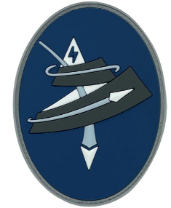







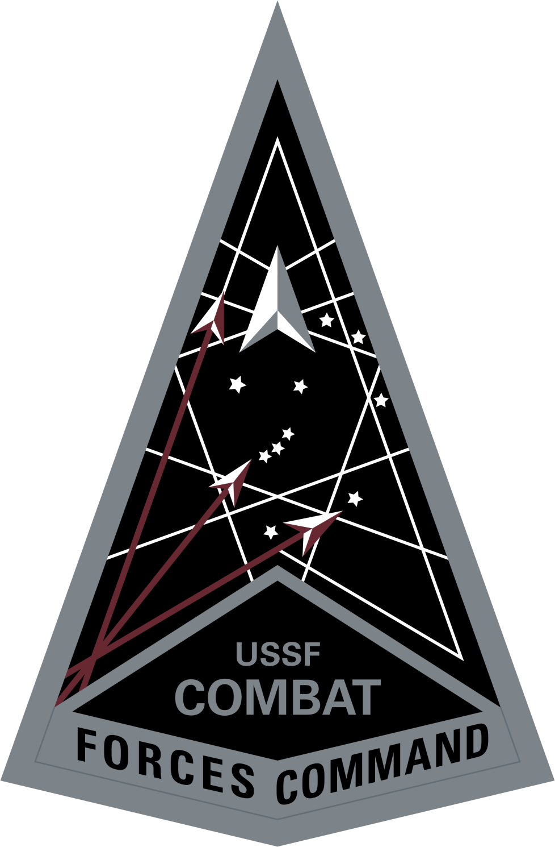

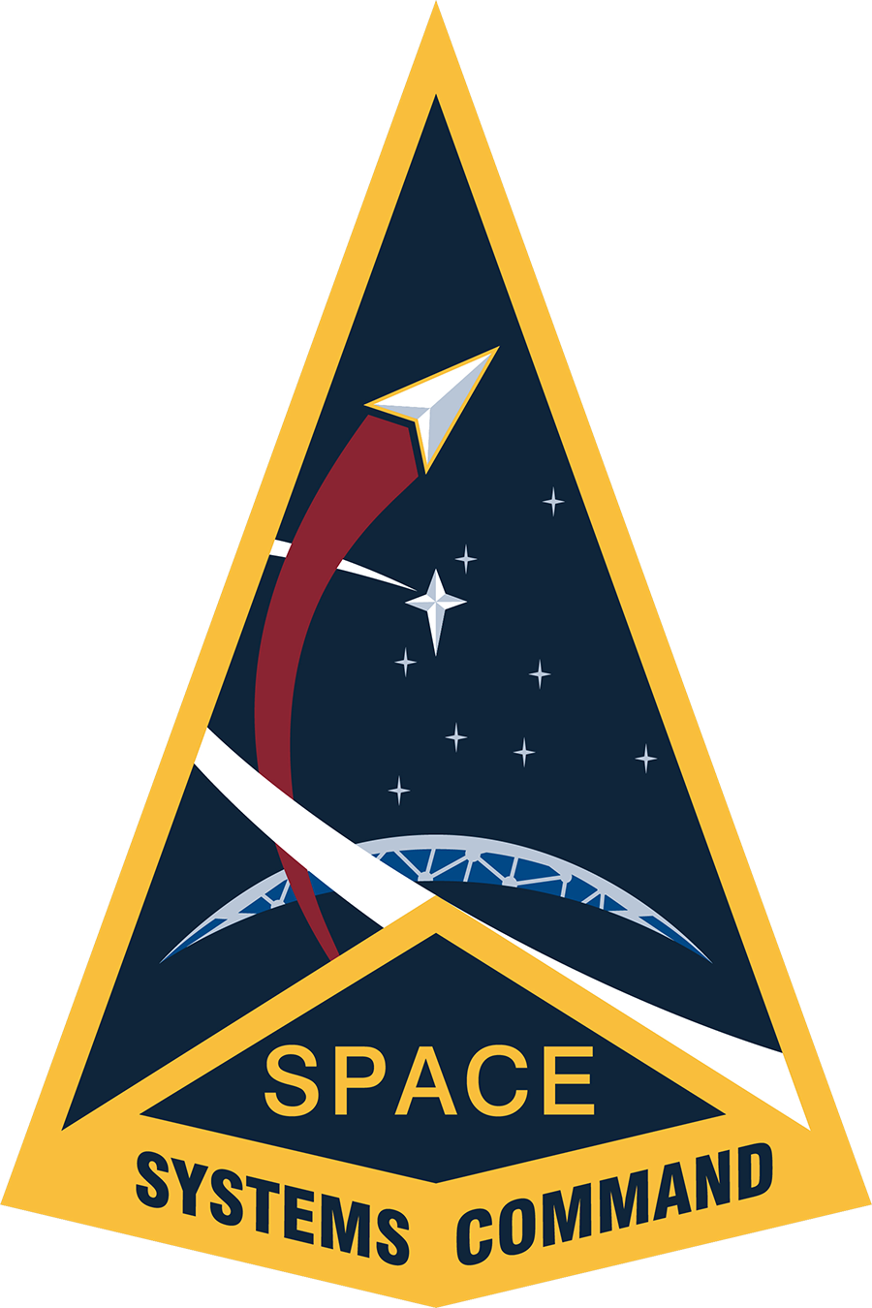




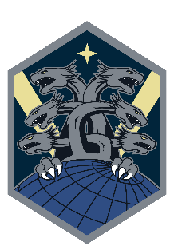


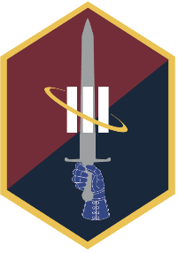





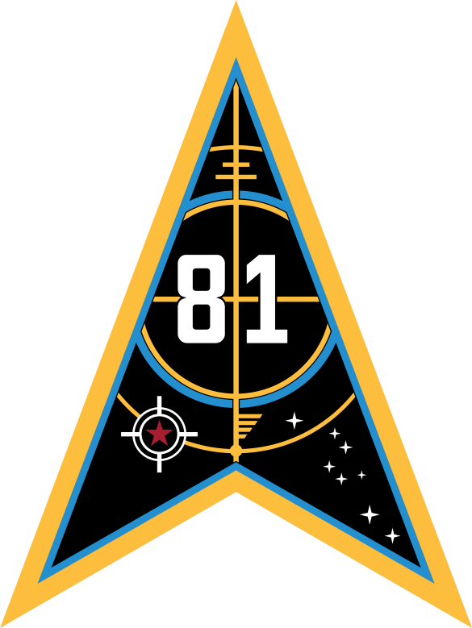
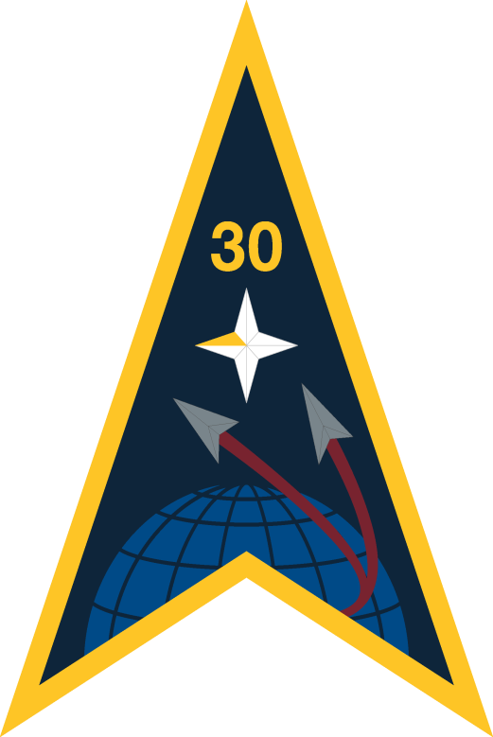

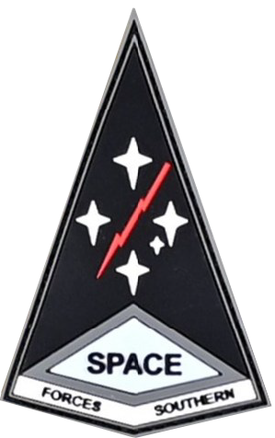





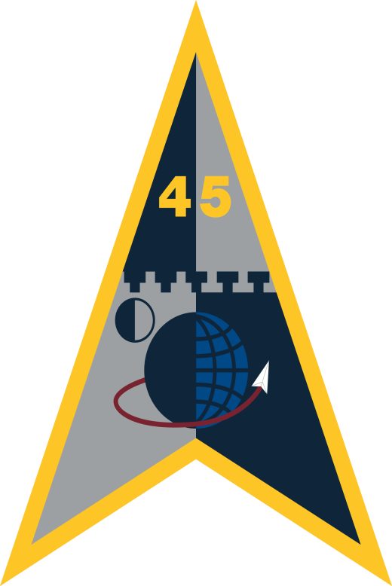




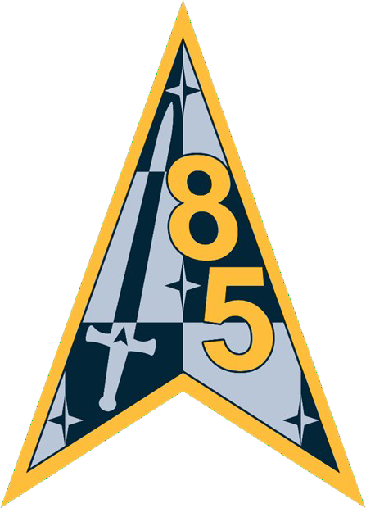





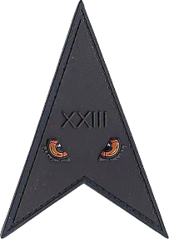



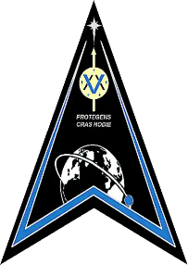


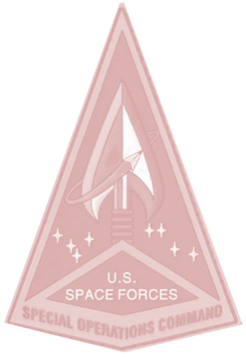



UNITED STATES SPACE FORCE ORGANIZATION
DIRECT REPORTING UNITS
FIELD OPERATING AGENCY
CSO
COMPONENT FIELD COMMANDS
Space Rapid
Capabilities Office
Kirtland
Space Development Agency
NCR
National Space
Intelligence Center
Wright-Patterson
Space Force Headquarters
Pentagon
DEL 5
CSpOC
Vandenberg
DEL 15
NSDC
Schriever
FIELD COMMANDS
SFSPACE
Vandenberg
SFJPN Yokota
SFKOR Osan
SFINDOPAC
Pearl Harbor-
Hickam
Combat Forces Command (CFC)
Peterson
Space Training and Readiness Command (STARCOM)
Patrick
Space Systems Command (SSC)
Los Angeles
Space Warfighting Analysis Command (SWAC)
TBD
SPACE FORCE ELEMENT
MD 2 SDA
Peterson
DEL 1
Training
Vandenberg
SYD 80 (P)
Assured Access To Space
Patrick
MAC
Mission Analysis
Center
Colorado Springs
SFEUR-AF
Ramstein
SBD 1
Peterson
SBD 3
LA
MD 3 SEW
Peterson
DEL 10
Doctrine/Wargaming
Patrick
SYD 81 (P)
Test and Training
Peterson
DEL 10
Wargaming
Patrick
SFCENT
MacDill
SBD 2
Buckley
SLD 30
Launch
Vandenberg
MD 4 MWT
Buckley
DEL 11
Range/Aggressor
Schriever
SYD 84 (P) SBMWT LA
DEL 14
Concepts and Technology TBD
SFELM/NRO
SLD 45
Launch
Patrick
DEL 20
MD 6
Cyber Ops
Schriever
SBD 41
Schriever
DEL 12
Test/Eval
Schriever
SYD 85 (P) BMC3I
Peterson
SFSOUTH
Davis-
Monthan
DEL 21
DEL 7 ISR
Peterson
SWAC
Space Warfighting Analysis Center
Colorado Springs
DEL 13
Education
Andrews
SYD 88 (P) SATCOM LA
DEL 23
SFNORTH
Peterson
MD 8 SATCOM
Schriever
SYD 89 (P)
Combat Power
LA
DEL 25
MD 9 OW
Schriever
SYD 810 (P) SBST
LA
SFSTRAT
Offutt
DEL 26
MD 31
PNT & Space Access
Schriever
SYD 831 (P) NAVWAR LA
COA: 5 DEC 25
SFSOC
MacDill

